Slide 1
How church works

Slide 4
How church works – The aim of Church

Slide 5
The commission of the church
is to make
disciples
not
converts

Slide 6
What’s the difference?
Converts are those who have accepted Jesus as Lord

Slide 7
Disciples are Christians
committed to
a life-long school of learning
to be
like Jesus …

Slide 8
Jesus, who brought
the kingdom of heaven
into ordinary,
everyday life

Slide 9
This Photo by Unknown Author is licensed under CC BY

Slide 10
That’s the mission of the church
That’s why we are church
That’s our job, together

Slide 11
How church works – Who does it?

Slide 12
And we all need each other to all be doing our jobs because Eph 4:12
And their calling is to nurture and prepare all the holy believers to do their own works of ministry, and as they do this they will enlarge and build up the body of Christ.

Slide 14
This Photo by Unknown Author is licensed under CC BY-ND

Slide 15
How church works – the foundation

Slide 16
All aspects of church life
do at least these 3 things
simultaneously:
They give us a place,
together:

Slide 17
a) to encounter God & learn His life & ways – be transformed into Jesus’ likeness
b) to live that out
c) to pass it on

Slide 18
That is one definition of discipling

Slide 19
The church is built on the foundation of the apostles and prophets, with Christ Jesus himself as the chief cornerstone. Eph 2:20

Slide 20
The apostolic stream
Like parents in a family who help us grow to maturity, this stream creates the safe place where we can learn to be like Jesus and pass that on

Slide 21
The prophetic stream
brings the word of God for the church body in encouragement,
upbuilding, comfort,
direction & correction.

Slide 22
How church works – built on that foundation

Slide 23
The pastoral stream
The glue of family life as church

Slide 24
The teaching stream
Helps us understand our faith more

Slide 25
The evangelistic stream
Helps us tell others how great Jesus is –
so that they join the family

Slide 26
The
pastoral, teaching & evangelistic streams
sit on the foundation of
the apostolic & prophetic

Slide 27
That is …

Slide 28
Without the safe place (apostolic) &
the living word of God active in the safe place (prophetic)
the other streams don’t function properly

Slide 29
All of the above means
we need
a leadership
that facilitates
all of the above

Slide 30
So what is the aim of leadership?

Slide 31
And we all need each other to all be doing our jobs because Eph 4:12
And their calling is to nurture and prepare all the holy believers to do their own works of ministry, and as they do this they will enlarge and build up the body of Christ.

Slide 32
The aim of the leadership is
to equip the body
- that is – US! -
for works of ministry together.

Slide 33
Another way of saying it:
leaders facilitate others
in their areas of service
to achieve their best

Slide 34
Please note –
The leaders’ job isn’t to do the job of the team members
The leaders’ job is to facilitate the team members to do their job

Slide 35
So what does that mean for our Leadership Team?
We’re to help create the safe place where we all learn to be like Jesus and pass that on

Slide 36
To help each of us fly as high as we can
To help each of us be the best we can be

Slide 37
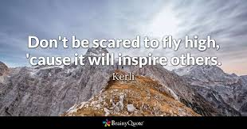

Slide 38
What’s your role in that relationship?
To seek to fly as high as you can
To seek to be the best you can be.

Slide 39
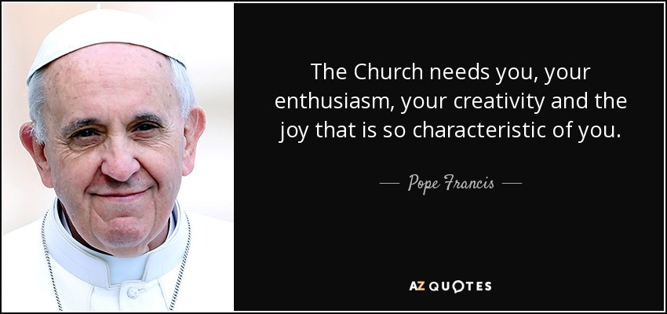

Slide 40
So, within this every-church format
the leadership
must keep the unique mandate of their church
firmly in the forefront of their planning

Slide 41
As The Bay’s mandate is so varied
the leadership must keep cohesion
around what we get up to at any given point
=
there will be many ideas but we won’t run with all of them instantly (maybe never)

Slide 42
Therefore
the Leadership Team
sets the direction and facilitates
all of us
to do the stuff to fulfill the mandate

Slide 43
And undergirding this is a church family that
prays
&
worships …

Slide 44
.. on our own
.. in groups
.. in church
.. at work/supermarket/wherever

Slide 45
Therefore ..
each of us has a part in fulfilling the mandate.
A vital part.

Slide 46
A very important aside …
There are those who need rest & recuperation and they will find that here

Slide 47
What’s your part?
Coz as you serve the church by fulfilling it
then ….

Slide 48
That’s How the bay church works

Slide 49
This Autumn we look at ..

Slide 50
As we dwell together in Him so He releases his power through us

Slide 51
As the early church was formed by them all dwelling together and waiting on God and then the power exploded …

Slide 52
… so we now become intentional around
Being together
Doing our part alongside each other
Looking to see our circles of influence be affected by His power through us

Slide 53
A season of expectation

Slide 54
One of encouraging ourselves in fully playing our part
One of encouraging and enabling others in The Bay family in fully playing their part

Slide 55
Because That’s How the bay church works

Slide 56
Because That’s How the bay church Grows

